Slide 1
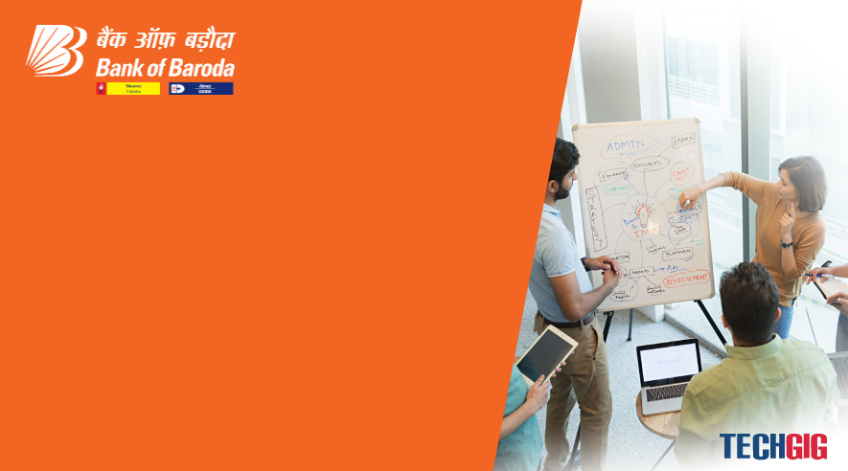

Bank of Baroda Hackathon - 2022
Technology Partner
Your Team Name : Mohankumar C B
Your team bio :
Date : 05/09/2022

Slide 2
Problem Statement?
Why did you decide to solve this Problem statement?
Because I have a great passion and I am very much interested in providing Innovative/Creative ideas and solutions to real world problems

Slide 3
User Segment & Pain Points
Which user /advertiser segment would be early adopter of your product & why?
The user segment mainly falls for the elderly age group who are little hesitant towards digital money transfer and who prefers the traditional way of transferring money using cheque instrument

Slide 4
Pre-Requisite
What are the alternatives/competitive products for the problem you are solving?
Electronic Money transfer such as google pay, paypal may be the competitive products.

Slide 5
Azure tools or resources
Azure tools or resources which are likely to be used by you for the prototype, if your idea gets selected
An application that runs in a cloud server which validates the cheque instrument after receiving the input data for a correponding cheque using a QR Code and then processes the information in the drawing bank server

Slide 6
Any Supporting Functional Documents
Present your solution, talk about methodology, architecture & scalability
A simple Cheque Processing machine shall be installed in various bank branches wherever customers can scan their cheques and instantly transfer money to their account. The functionality of the Cheque Processing machine can be implemented as a feature in all existing ATMS or Cash depositing machines using a QR code scanner and image recognition
This Cheque Processing machine scans a cheque using a unique QR code which provides the cheque static details such as Account holder Name, Account Number, Cheque number and the drawing bank details. The Cheque processing machine shall also get the details entered by the drawer such as cheque amount, cheque date and signature using image recognition from the scanned cheque instrument. These details are sent to the drawing bank and the following details are verified.
Customer account is ensured for sufficient funds against the amount mentioned in the Cheque
Cheque date is verified
Signature verification is done.
After verifying all the above details from the drawing bank side, the cheque is passed and the beneficiary account is credited with the amount mentioned in the cheque. The Cheque can be collected by the machine for future reference and a receipt can be given to the customer
By the above way, the cheque is instantly processed and there is no need for longer processing time anymore

Slide 7
Key Differentiators & Adoption Plan
How is your solution better than alternatives and how do you plan to build adoption?
Using my solution approach, the cheque is instantly processed, the beneficiary account is credited instantly and hence there is no need for longer processing time anymore.
Since the customer directly places the cheques in the machine, there is minimal or zero human intervention to complete the process
And Finally, the features of the traditional cheque instrument and its usage remains unmodified

Slide 8
GitHub Repository Link & supporting diagrams, screenshots, if any
How far it can go?

Slide 9
Thank You
Team member names
C B Mohankumar

